Slide 1

Oral Health Overview
Dr. Diane Bonanni
Introduction to the mouth
Oral care/hygiene
Over-the-counter teeth whitening products
Smokeless and smoking tobacco
Oral Piercing
HPV
Oral Cancer

Slide 2
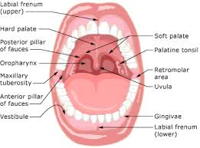
Oral Cavity
Notes:
Take your tongue and feel how smooth and moist the oral tissue feels. Under the tissue lies accessory salivary glands that continually pump out saliva containing many elements that keep the mouth healthy. The oral tissues are permeable and allow and constant flow back and forth from the mouth.

Slide 3
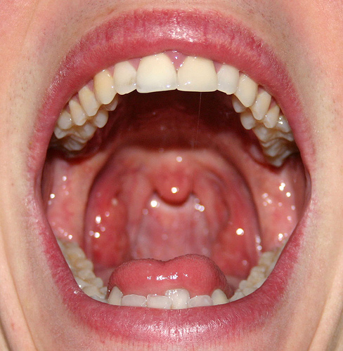
Oral Cavity
Notes:
The mouth is the beginning of the digestive tract and houses the greatest number of bacteria of the digestive tract. The goal of oral health is to keep the numbers of bacteria decreased. Remember that even though the oral tissues feel smooth they are permiable.

Slide 4
Oral health Affects Total health
When gums are infected and inflamed from bacterial plaque , that bacteria can spread and grow below the gum line. The bacteria can spread and enter into the blood stream and travel to major organs and begin new infections.
Research supports that gum disease is linked to heart disease, osteoporosis and diabetes.

Slide 5
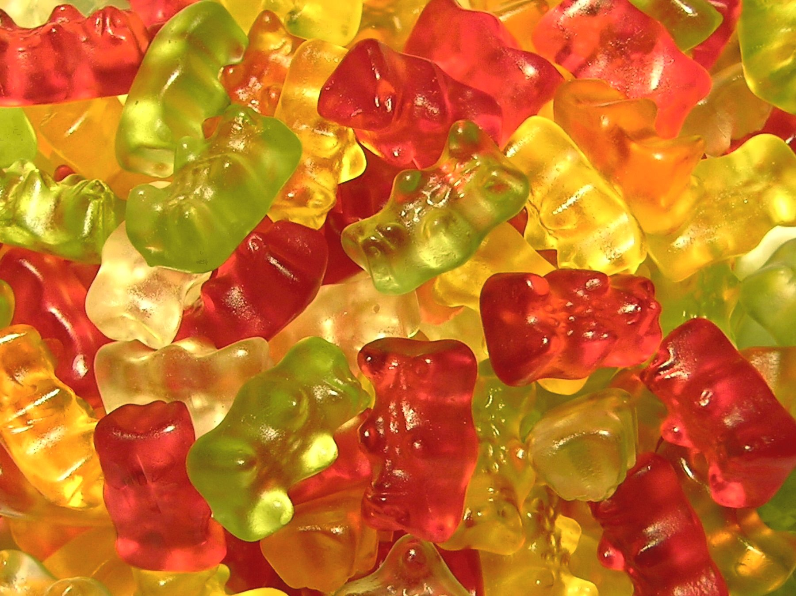
Retentive sugar
Notes:
One of the ways to keep the numbers of bacteria down is to lessen carbohydrate consumption.

Slide 6
What’s wrong with refined sugar?
Sugar + bacteria= acid byproduct
Acid on a susceptible surface will break down that tissue ( your teeth and gums )
Now you see why it is important to remove the bacteria from your teeth and gums

Slide 7
Decrease Carbohydrate consumption
1. Stay away from things that stick. Besides how often you snack on sugary foods, the LENGTH of time that it remains in your mouth plays a large role in tooth decay.
2. Think twice about picking hard candy. Unless it is sugar free, candies stay in the mouth for a long period of time and subject teeth to increased risk of decay

Slide 8
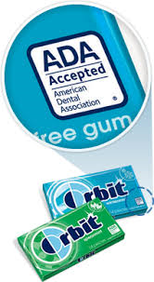
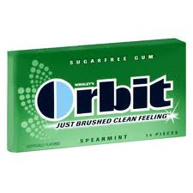
Gum
Notes:
Chew gum with the ADA seal of approval. Studies show that chewing sugarless gum for 20 minutes after a meal reduces tooth decay and increases salivary flow.

Slide 9
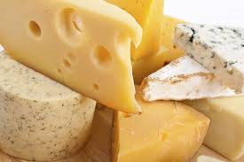
Cheese
Notes:
Snack on foods that have a low fermentable rate.

Slide 10
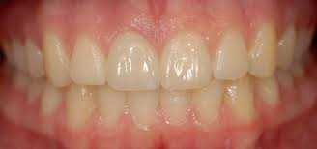
Healthy Gums & Soft Tissue
Notes:
Look at the nice pink gum tissue that holds firm to the teeth

Slide 11
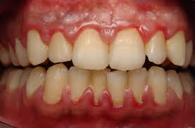
Unhealthy Gums & Soft Tissue
Notes:
Look at the reddened rolled shiney gum tissue that has the spongy appearance. Notice also the layer of bacterial plaque at the gumline.

Slide 12

Brushing Teeth
Notes:
Brushing removes the bacteria and food from the outer, inner, and chewing surfaces of your teeth. Take time to brush your teeth thoroughly every day. A soft bristle tooth brush is recommended. Remember to replace your tooth brush every three months. Worn out tooth brushes cannot properly clean your teeth and may injure your gums.
(insert colgate you tube of how to brush and floss)

Slide 13
FLOSSING
Notes:
Flossing between your teeth and under the gum line removes the acid causing foods and bacteria where your tooth brush can not reach. Since tooth decay and periodontal disease often start in these areas, it is important to clean them thoroughly at least once a day.

Slide 14
SMOKING

Slide 15
Quitting
Smoking is a difficult habit to break, but you can do it! Quitting is the only way to decrease your risk of tobacco-related health problems. The addictive quality of nicotine, which is found in cigarettes, cigars and chewing tobacco, can make this especially difficult. That’s why it’s important to have a plan and a support network, people to help you stick to your plan. Write down your reasons for quitting. Exercising, chewing gum and keeping yourself occupied can help you quit. Talk to your dentist or doctor to see if the medications available would help you to stop using tobacco.

Slide 16
What poisons are added to tobacco?
1.Polonium 210 ( nuclear waste )
2. N-Nitrosamines ( cancer causing compounds)
3. Formaldehyde ( embalming fluid )
4. Nicotine ( addictive drug )
5. Cadmium ( used in batteries )
6. Cyanide
7. Arsenic
8. Benzene
9. Lead

Slide 17
Harm
Chewing tobacco can harm your health because it contains toxins, which can cause gum disease. Other possible oral health impacts of tobacco products include: stained teeth and tongue; dulled sense of taste and smell; slow healing after a tooth extraction or other surgery; difficulties in correcting cosmetic dental problems; and oral cancer.

Slide 18
Bad Breath
Just like cigarettes, using chewing tobacco will give you bad breath. But most importantly, it also puts you at risk for many diseases and decreases your life expectancy. Quitting is hard but you can do it. Take it day by day, hour by hour, and reward yourself for small successes. With all the money you save on tobacco products, you can treat yourself to a stress-relieving massage or a nice vacation.

Slide 19
Teeth fall out
You know smoking is bad for you, so it should be no surprise that cigarettes and chewing tobacco are also harmful to your dental health. For one, tobacco products can cause bad breath, but that’s only the beginning. Repeated use of chewing tobacco can lead to gum disease which, if left untreated, can eventually lead to tooth loss. Other possible health impacts include a dulled sense of taste and smell, slow healing after a tooth extraction, and mouth cancer.

Slide 20
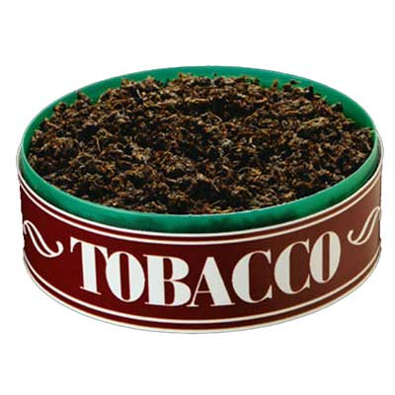
Addictive
Because it contains nicotine, chewing tobacco is just as addictive as other forms of tobacco, including cigarettes. Talk to your dentist or physician to see if the medications available would help you to stop using tobacco.

Slide 21
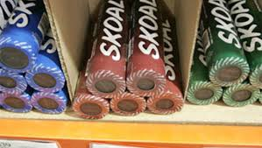
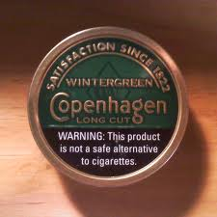
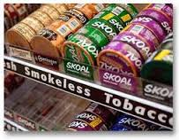
Chewing Tobacco
Notes:
Snuff tobacco is usually sold in cans or in other forms here. Just a pinch is needed to release the nicotine that is quickly absorbed in the bloodstream resulting in a quick high. Most often these products are flavored to attract a younger market share.

Slide 22
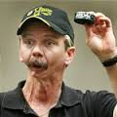
Oral Cancer

Slide 23
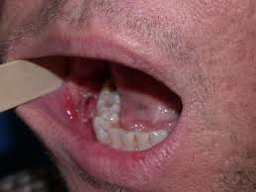
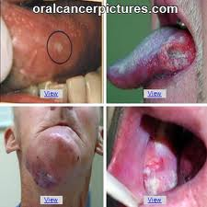
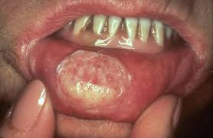
Cancer Lesions

Slide 24
Smokeless tobacco
American Medical Association calculated that smokeless tobacco users who use “chew” or dip 8 to 10 times a day could be exposed to the same amount of nicotine as people who smoke 30-40 cigarettes a day.

Slide 25
This next slide will tell the story of Gruen Von Behrens.
He was on his way to the major leagues when at age 17 he was diagnosed with oral cancer.
This is a testimonial how that changed his life forever.

Slide 26
Gruen Von Behrens

Slide 27
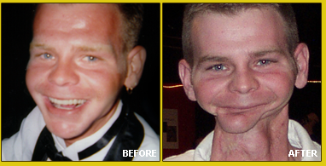
Gruen Von Behrens
Notes:
This is Gruen after 27 and counting surgeries for facial reconstruction.

Slide 28
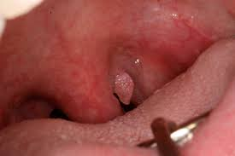
Oral Cancer

Slide 29
Early warning signs
A sore in your mouth that will not heal and bleeds easily
A lump or thickening anywhere in your mouth or neck
Soreness or swelling that does not go away
Red or white patch that does not go away
Trouble swallowing, chewing or moving your tongue or jaw

Slide 30
Oral cancer and HPV
The American Cancer Society diagnosis estimated 30,000 new cases each year. Oral cancer includes cancer of the lip, tongue, pharynx, jaw bone and oral cavity.
Human Papilloma Virus can present in any age group.
Any teen , college student or 60 year old can present with oral cancer with a connect with HPV
A strain of HPV is among the causative factors for Nasopharyngeal cancer.
PRACTICING SAFE SEX IS A MUST TO PREVENT CANCER.

Slide 31
HPV Vaccine
90% decrease in infection of HPV with the vaccine

Slide 32
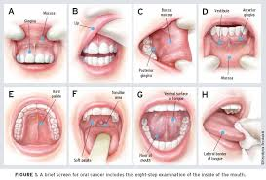
Oral Cancer Exam

Slide 33
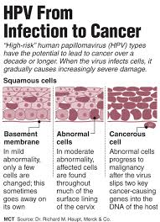
Human Papillomavirus

Slide 34
Oral Cancer Treatments
Will vary depending on the type and extent of cancer diagnosed.
Two percent of all deaths in the U.S. are oral cancer related.
Almost any cancer when caught at an early stage can be treated successfully with surgery, radiation and chemotherapy.

Slide 35
Rehabilitation
May require Prosthetics and cosmetic surgery, speech and swallowing therapy and physical therapy.

Slide 36
Oral Piercing
Body piercing is a popular form of self-expression. Oral piercings or tongue splitting may look cool, but they can be dangerous to your health. That’s because your mouth contains millions of bacteria, and infection and swelling often occur with mouth piercings.

Slide 37
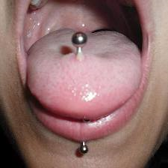

Slide 38
Oral Piercing cont.
For instance, your mouth and tongue could swell so much that you close off your airway or you could possibly choke if part of the jewelry breaks off in your mouth. In some cases, you could crack a tooth if you bite down too hard on the piercing, and repeated clicking of the jewelry against teeth can also cause damage. Oral piercing could also lead to more serious infections, like hepatitis or endocarditis.

Slide 39
Oral Piercing cont.
If you pierce your tongue, lips, cheeks or uvula (the tiny tissue that hangs at the back of the throat,) it can interfere with speech, chewing or swallowing. It may also cause:

Slide 40
Infection, pain and swelling
Infection, pain and swelling. Your mouth is a moist environment, home to huge amounts of breeding bacteria, and an ideal place for infection. An infection can quickly become life threatening if not treated promptly. It’s also possible for a piercing to cause your tongue to swell, potentially blocking your airway.

Slide 41
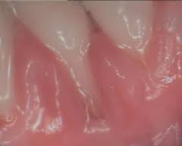
RECESSION

Slide 42
Damage to gums, teeth and filllings
Damage to gums, teeth and fillings. A common habit of biting or playing with the piercing can injure your gums and lead to cracked, scratched or sensitive teeth. Piercings can also damage fillings

Slide 43
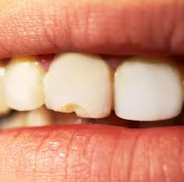
TOOTH FRACTURE

Slide 44
Hypersensitivity to metals
Hypersensitivity to metals. Allergic reactions at the pierced site are also possible.

Slide 45
Nerve Damage
Nerve damage. After a piercing, you may experience a numb tongue that is caused by nerve damage that is usually temporary, but can sometimes be permanent. The injured nerve may affect your sense of taste, or how you move your mouth. Damage to your tongue’s blood vessels can cause serious blood loss

Slide 46
Excessive Drooling
Excessive drooling. Your tongue piercing can increase saliva production.

Slide 47
Dental Appointment difficulties
Dental appointment difficulties. The jewelry can get in the way of dental care by blocking X-rays.

Slide 48
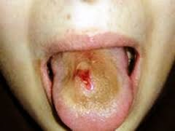
Already have an oral piercing?
Contact your dentist or physician immediately if you have any signs of infection—swelling, pain, fever, chills, shaking or a red-streaked appearance around the site of the piercing.

Slide 49
Oral Piercing Care
1. Keep the piercing site clean and free of any matter that may collect on the jewelry by using a mouth rinse after every meal.
2. Try to avoid clicking the jewelry against teeth and avoid stress on the piercing. Be gentle and aware of the jewelry’s movement when talking and chewing.
3. Check the tightness of your jewelry periodically (with clean hands). This can help prevent you from swallowing or choking if the jewelry becomes dislodged

Slide 50
Oral Piercing Care cont.
4. When taking part in sports, remove the jewelry and protect your mouth with a mouthguard.
5. See your dentist regularly, and remember to brush twice a day and floss daily.

Slide 51
Remove mouth jewelry
Of course the best option is to consider removing mouth jewelry before it causes a problem. Don’t pierce on a whim. The piercing will be an added responsibility to your life, requiring constant attention and upkeep. Talk to your dentist for more information.

Slide 52
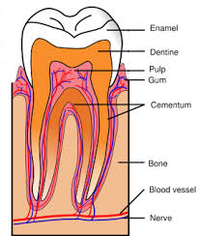
Tooth Enamel

Slide 53
The enamel is the outer layer of the tooth
The function is to protect the tooth
It is a clear layer
Its structure is straight rows of enamel rods with collagen matrix

Slide 54
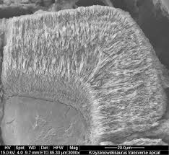
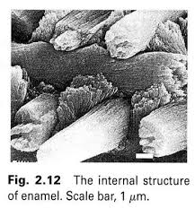
Enamel structure

Slide 55
Teeth whitening…Can you over do it?
Teeth whitening is one of the easiest procedures that can be done to improve the appearance of a smile.
In the U.K. it is illegal to sell products over the counter with a greater than 6% hydrogen peroxide content and the use of 35% hydrogen peroxide can be administered by a licensed dentist. In the United States, these products are allowed over-the-counter.

Slide 56
Tooth Changes with tooth whitening
Chemistry: Hydrogen peroxide breaks down into oxygen radicals which destroy stain molecules in the teeth
Higher concentrations 35%, can cause changes in the tooth enamel that make it rough and loss of strength and phosphate content in the deeper layers.

Slide 57
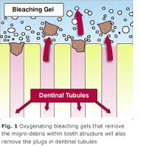
Teeth whitening mechanism with a neutral or basic pH
Notes:
Here it shows the enamel matrix oxidizing and leaving spaces between the enamel rods. While that is happening, the rods collapse on each other creating a dense mass. This gives the illusion of a white tooth.

Slide 58
Whitening studies
Under a microscope, enamel that was overexposed to hydrogen peroxide was found to be porous and the dentin had enzymes that break down collagen and disrupt the organic matrix.
This has a dramatic result on the inner live nerve/pulp.
The misuse/ prolonged frequent use of the over the counter whitening products with high concentrations of whitening will cause irreversible tooth damage.

Slide 59
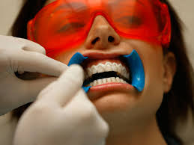
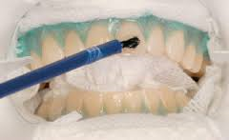
Teeth Whitening
Notes:
Teeth Whitening in the office is the safest method of tooth whitening. All of the permeable soft tissue is protected and isolated. Whitening gel is applied to the tooth structure.

Slide 60
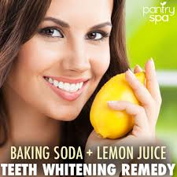
SCAMS

Slide 61
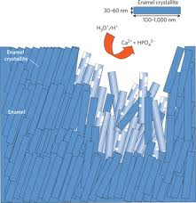
Acid on tooth enamel
Notes:
The acid attacks both the enamel matrix and the enamel rods and removes a piece of enamel. Once enamel is removed it can not be regenerated. Repeated use of an acid on the enamel creates erosion and sensitivity.

Slide 62
Fact or Fiction
There's no harm in chewing tobacco.
Fact
Fiction

Slide 63
Using chewing tobacco gives you bad breath.
Fact
Fiction

Slide 64
Chewing tobacco is the best way to quit smoking cigarettes.
Fact
Fiction

Slide 65
Chewing tobacco is not as addictive as cigarettes.
Fact
Fiction

Slide 66
Using chewing tobacco can make your teeth fall out.
Fact
Fiction

Slide 67
Oral piercing can cause nerve damage.
Fact
Fiction

Slide 68
The oral cavity is the beginning of the digestive system and has the least amount of bacteria of that system.
Fact
Fiction

Slide 69
Teeth whitening can be done repetitively without any tooth damage.
Fact
Fiction

Slide 70
The safest method of teeth whitening is to be done in your dentist office.
Fact
Fiction

